Slide 1
Introduction to Machine Learning and Data Mining (Học máy và Khai phá dữ liệu)
Khoat Than
School of Information and Communication Technology
Hanoi University of Science and Technology

Slide 2
Contents
Introduction to Machine Learning & Data Mining
Unsupervised learning
Supervised learning
Support Vector Machines
Practical advice

Slide 3
Support Vector Machines (1)
Support Vector Machines (SVM) (máy vectơ hỗ trợ) was proposed by Vapnik and his colleages in 1970s. Then it became famous and popular in 1990s.
Originally, SVM is a method for linear classification. It finds a hyperplane (also called linear classifier) to separate the two classes of data.
For non-linear classification for which no hyperplane separates well the data, kernel functions (hàm nhân) will be used.
Kernel functions play the role to transform the data into another space, in which the data is linearly separable.
Sometimes, we call linear SVM when no kernel function is used. (in fact, linear SVM uses a linear kernel)

Slide 4
Support Vector Machines (2)
SVM has a strong theory that supports its performance.
It can work well with very high dimensional problems.
It is now one of the most popular and strong methods.
For text categorization, linear SVM performs very well.

Slide 5
1. SVM: the linearly separable case
Problem representation:
Training data D = {(x₁, y₁), (x₂, y₂), …, (x_{r}, y_{r})} with r instances.
Each x_{i} is a vector in an n-dimensional space, e.g., x_{i} = (x_{i1}, x_{i2}, …, x_{in})^{T}. Each dimension represents an attribute.
Bold characters denote vectors.
y_{i} is a class label in {-1; 1}. ‘1’ is possitive class, ‘-1’ is negative class.
Linear separability assumption: there exists a hyperplane (of linear form) that well separates the two classes (giả thuyết tồn tại một siêu phẳng mà phân tách 2 lớp được)

Slide 6
Linear SVM
SVM finds a hyperplane of the form:
f(x) = ⟨w ⋅ x⟩ + b
w is the weight vector; b is a real number (bias).
⟨w ⋅ x⟩ and ⟨w, x⟩ denote the inner product of two vectors (tích vô hướng của hai véctơ)
Such that for each x_{i}:
[Eq.1]
[Eq.2]

Slide 7
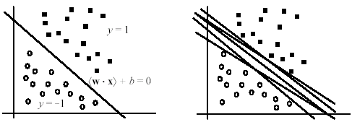
Separating hyperplane
The hyperplane (H₀) which separates the possitive from negative class is of the form:
⟨w ⋅ x⟩ + b = 0
It is also known as the decision boundary/surface.
But there might be infinitely many separating hyperplanes. Which one should we choose?
[Liu, 2006]

Slide 8
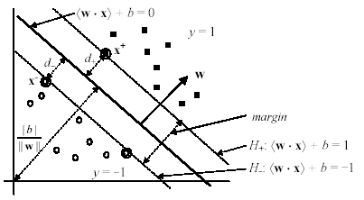
Hyperplane with max margin
SVM selects the hyperplane with max margin. (SVM tìm siêu phẳng tách mà có lề lớn nhất)
It is proven that the max-margin hyperplane has minimal errors among all possible hyperplanes.
[Liu, 2006]

Slide 9
Marginal hyperplanes
Assume that the two classes in our data can be separated clearly by a hyperplane.
Denote (x⁺,1) in possitive class and (x⁻,-1) in negative class which are closest to the separating hyperplane H₀ (⟨w ⋅ x⟩ + b = 0)
We define two parallel marginal hyperplanes as follows:
H₊ crosses x⁺ and is parallel with H₀: ⟨w ⋅ x⁺⟩ + b = 1
H₋ crosses x⁻ and is parallel with H₀: ⟨w ⋅ x⁻⟩ + b = -1
No data point lies between these two marginal hyperplanes. And satisfying:
⟨w ⋅ x_{i}⟩ + b ≥ 1, if y_{i} = 1
⟨w ⋅ x_{i}⟩ + b ≤ -1, if y_{i} = -1
[Eq.3]

Slide 10
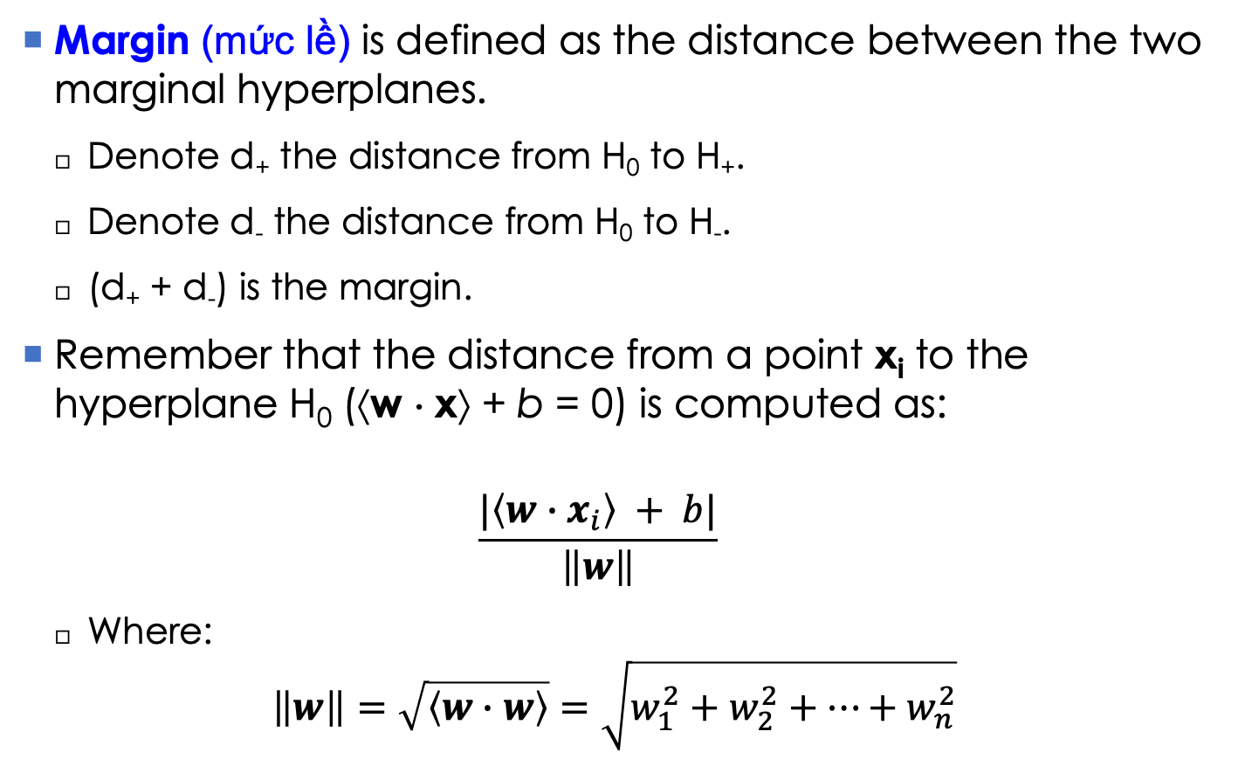
The margin (1)
Margin (mức lề) is defined as the distance between the two marginal hyperplanes.
Denote d₊ the distance from H₀ to H₊.
Denote d₋ the distance from H₀ to H₋.
(d₊ + d₋) is the margin.
Remember that the distance from a point x_{i} to the hyperplane H₀ (⟨w ⋅ x⟩ + b = 0) is computed as:
$$\frac{|\left\langle w∙x_{i}\right\rangle + b|}{\left\|w\right\|}$$
Where:
$$\left\|w\right\|=\sqrt{\left\langle w∙w\right\rangle }=\sqrt{w_{1}^{2}+w_{2}^{2}+…+w_{n}^{2}}$$
[Eq.4]
[Eq.5]

Slide 11
The margin (2)
So the distance d₊ from x⁺ to H₀ is
Similarly, the distance d₋ from x⁻ to H₀ is
As a result, the margin is:
[Eq.6]
[Eq.7]
[Eq.8]

Slide 12
SVM: learning with max margin (1)
SVM learns a classifier H₀ with a maximum margin, i.e., the hyperplane that has the greatest margin among all possible hyperplanes.
This learning principle can be formulated as the following quadratic optimization problem:
Find w and b that maximize
and satisfy the below conditions for any training data x_{i}:

Slide 13
SVM: learning with max margin (2)
Learning SVM is equivalent to the following minimization problem:
Minimize
Conditioned on
Note, it can be reformulated as:
Minimize
Conditioned on
This is a constrained optimization problem.
[Eq.9]
[Eq.10]
(P)

Slide 14
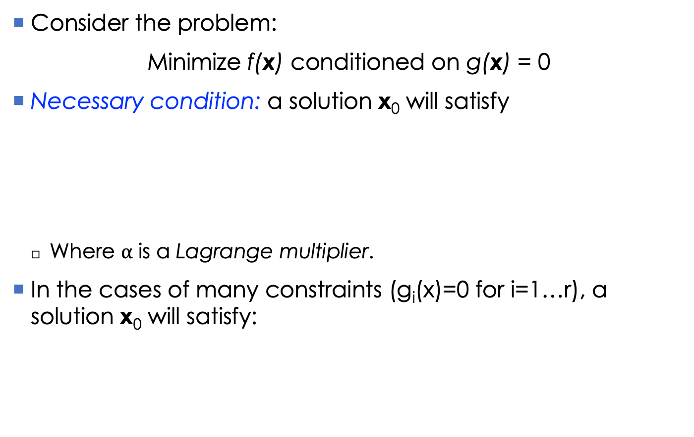
Constrained optimization (1)
Consider the problem:
Minimize f(x) conditioned on g(x) = 0
Necessary condition: a solution x₀ will satisfy
Where $α$ is a Lagrange multiplier.
In the cases of many constraints (g_{i}(x)=0 for i=1…r), a solution x₀ will satisfy:

Slide 15
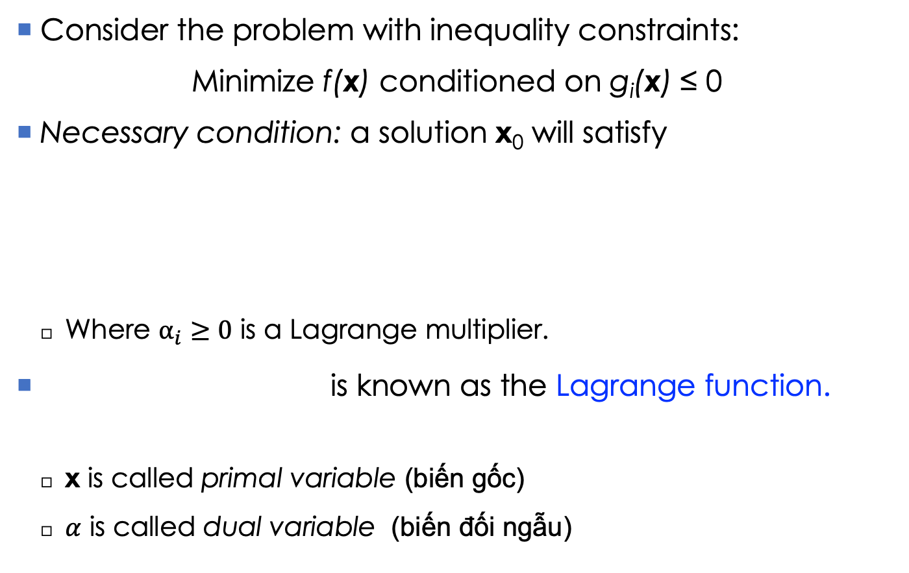
Constrained optimization (2)
Consider the problem with inequality constraints:
Minimize f(x) conditioned on g_{i}(x) ≤ 0
Necessary condition: a solution x₀ will satisfy
Where $α_{i}≥0$ is a Lagrange multiplier.
is known as the Lagrange function.
x is called primal variable (biến gốc)
$α$ is called dual variable (biến đối ngẫu)

Slide 16

SVM: learning with max margin (3)
The Lagrange function for problem [Eq. 10] is
Where each $α_{i}≥0$ is a Lagrange multiplier.
Solving [Eq. 10] is equivalent to the following minimax problem:
[Eq.11a]
[Eq.11b]

Slide 17
SVM: learning with max margin (4)
The primal problem [Eq. 10] can be derived by solving:
Its dual problem (đối ngẫu) can be derived by solving:
It is known that the optimal solution to [Eq. 10] will satisfy some conditions which is called the Karush-Kuhn-Tucker (KKT) conditions.

Slide 18

SVM: Karush-Kuhn-Tucker
[Eq.12]
The last equation [Eq. 16] comes from a nice result from the duality theory.
Note: any $α_{i}>0$ will imply that the associated point x_{i} lies in a boundary hyperplane (H₊ or H₋).
Such a boundary point is named as a support vector.
A non-support vector will correspond to $α_{i}=0$.
[Eq.13]
[Eq.14]
[Eq.15]
[Eq.16]

Slide 19
SVM: learning with max margin (5)
In general, the KKT conditions do not guarantee the optimality of the solution.
Fortunately, due to the convexity of the primal problem [Eq.10], the KKT conditions are both necessary and sufficient to assure the global optimality of the solution. It means a vector satisfying all KKT conditions provides the globally optimal classifier.
Convex optimization is ‘easy’ in the sense that we always can find a good solution with a provable guarantee.
There are many algorithms in the literature, but most are iterative.
In fact, problem [Eq.10] is pretty hard to derive an efficient algorithm. Therefore, its dual problem is more preferable.

Slide 20

SVM: the dual form (1)
Remember that the dual counterpart of [Eq.10] is
By taking the gradient of L(w,b,$α$) in variables (w,b) and zeroing it, we can find the following dual function:
[Eq.17]

Slide 21
SVM: the dual form (2)
Solving problem [Eq.10] is equivalent to solving its dual problem below:
Maximize
Such that
The constraints in (D) is much more simpler than those of the primal problem. Therefore deriving an efficient method to solve this problem might be easier.
However, existing algorithms for this problem are iterative and complicated. Therefore, we will not discuss any algorithm in detail !
[Eq.18]
(D)

Slide 22

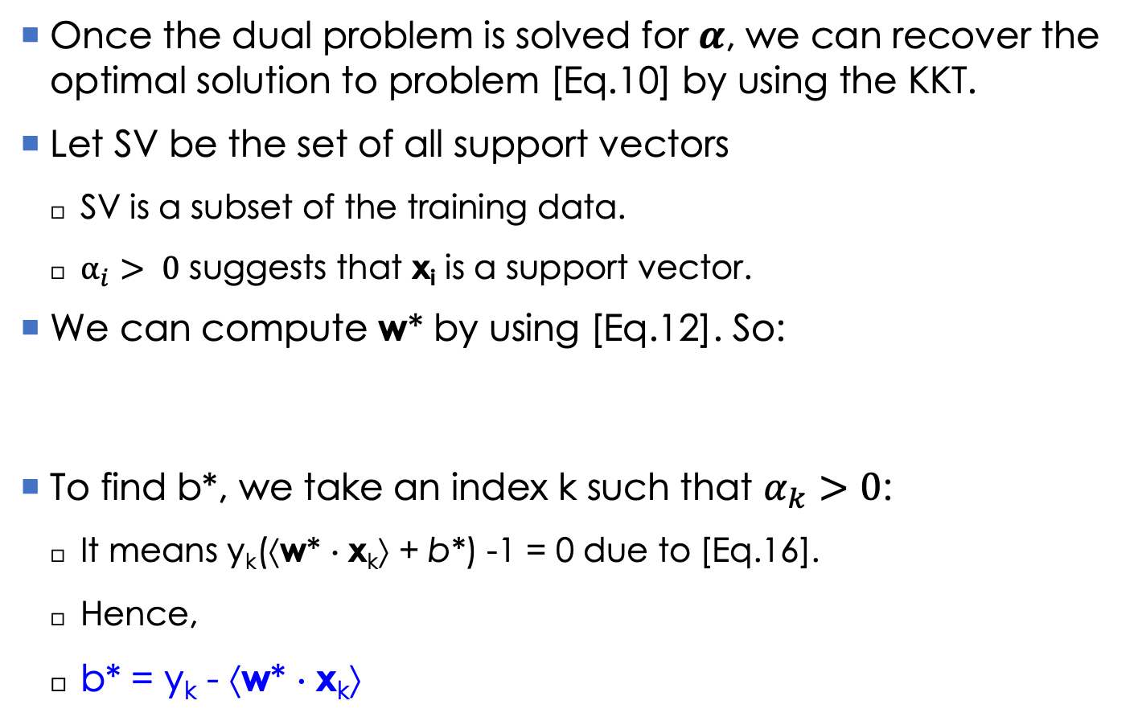
SVM: the optimal classifier
Once the dual problem is solved for $α$, we can recover the optimal solution to problem [Eq.10] by using the KKT.
Let SV be the set of all support vectors
SV is a subset of the training data.
$α_{i}> 0$ suggests that x_{i} is a support vector.
We can compute w* by using [Eq.12]. So:
To find b*, we take an index k such that $α_{k}>0$:
It means y_{k}(⟨w* ⋅ x_{k}⟩ + b*) -1 = 0 due to [Eq.16].
Hence,
b* = y_{k} - ⟨w* ⋅ x_{k}⟩
(due to $α_{j}=0$ for any x_{j} not in SV)

Slide 23
SVM: classifying new instances
The decision boundary is
For a new instance z, we compute:
If the result is 1, z will be assigned to the possitive class; otherwise z will be assigned to the negative class.
Note that this classification principle
Just depends on the support vectors.
Just needs to compute some dot products.
[Eq.19]
[Eq.20]

Slide 24
2. Soft-margin SVM
What if the two classes are not linearly separable? (Trường hợp 2 lớp không thể phân tách tuyến tính thì sao?)
Linear separability is ideal in practice.
Data are often noisy or erronous, making two classes overlapping (nhiễu/lỗi có thể làm 2 lớp giao nhau)
In the case of linear separability:
Minimize
Conditioned on
In the cases of noises or overlapping, those constraints may never meet simutaneously.
It means we cannot solve for w* and b*.

Slide 25
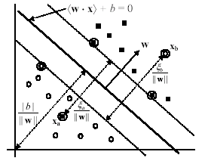
Example of inseparability
Noisy points x_{a} and x_{b} are mis-placed.

Slide 26
Relaxing the constraints
To work with noises/errors, we need to relax the constraints about margin by using some slack variables ξ_{i} (≥ 0): (Ta sẽ mở rộng ràng buộc về lề bằng cách thêm biến bù)
⟨w⋅x_{i}⟩+b ≥ 1−ξ_{i} if y_{i} = 1
⟨w⋅x_{i}⟩+b ≤ −1+ξ_{i} if y_{i} = -1
For a noisy/erronous point x_{i}, we have: ξ_{i} >1
Otherwise ξ_{i} = 0.
Therefore, we have the following constraints for the cases of linear inseparability:
y_{i}(⟨w⋅x_{i}⟩ + b) ≥ 1−ξ_{i} for all i = 1…r
ξ_{i} ≥ 0 for all i = 1…r

Slide 27
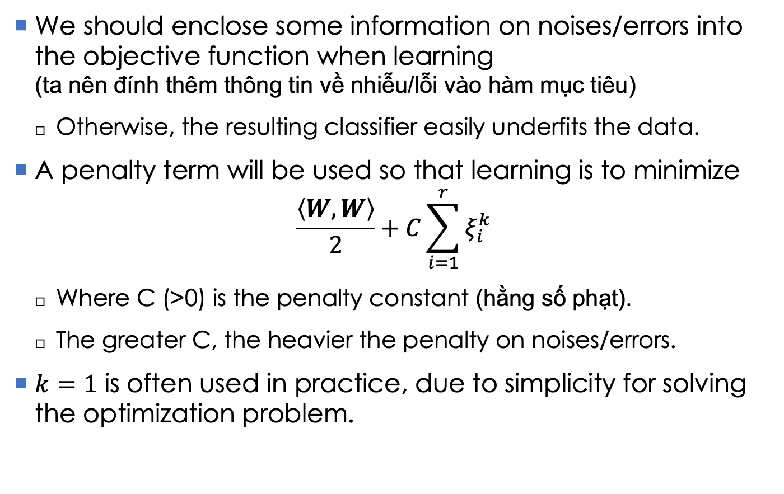
Penalty on noises/errors
We should enclose some information on noises/errors into the objective function when learning (ta nên đính thêm thông tin về nhiễu/lỗi vào hàm mục tiêu)
Otherwise, the resulting classifier easily underfits the data.
A penalty term will be used so that learning is to minimize
$$\frac{\left\langle W,W\right\rangle }{2}+C\sum_{i=1}^{r}{ξ_{i}^{k}}$$
Where C (>0) is the penalty constant (hằng số phạt).
The greater C, the heavier the penalty on noises/errors.
$k=1$ is often used in practice, due to simplicity for solving the optimization problem.

Slide 28
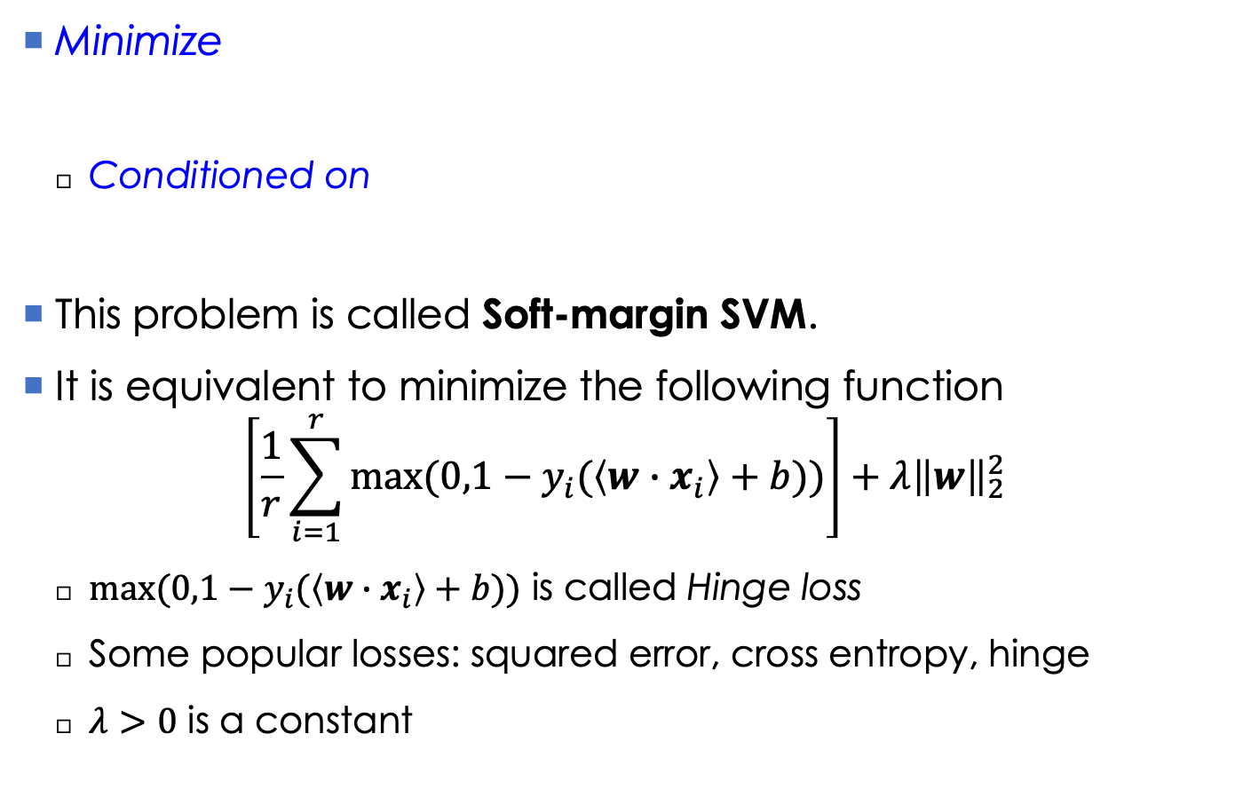
The new optimization problem
Minimize
Conditioned on
This problem is called Soft-margin SVM.
It is equivalent to minimize the following function
$$\left[\frac{1}{r}\sum_{i=1}^{r}{max⁡(0,1−y_{i}(\left\langle w∙x_{i}\right\rangle +b))}\right]+λ{\left\|w\right\|}_{2}^{2}$$
$max⁡(0,1−y_{i}(\left\langle w∙x_{i}\right\rangle +b))$ is called Hinge loss
Some popular losses: squared error, cross entropy, hinge
$λ>0$ is a constant
[Eq.21]

Slide 29
The new optimization problem
Its Lagrange function is
Where α_{i} (≥0) and μ_{i} (≥0) are Lagrange multipliers.
[Eq.22]

Slide 30
Karush-Kuhn-Tucker conditions (1)
[Eq.23]
[Eq.24]
[Eq.25]

Slide 31
Karush-Kuhn-Tucker conditions (2)
[Eq.26]
[Eq.27]
[Eq.28]
[Eq.29]
[Eq.30]
[Eq.31]

Slide 32
The dual problem
Maximize
Such that
Note that neither ξ nor μ_{i} appears in the dual problem.
This problem is almost similar with that [Eq.18] in the case of linearly separable classification.
The only difference is the constraint: α_{i} ≤C
[Eq.32]

Slide 33

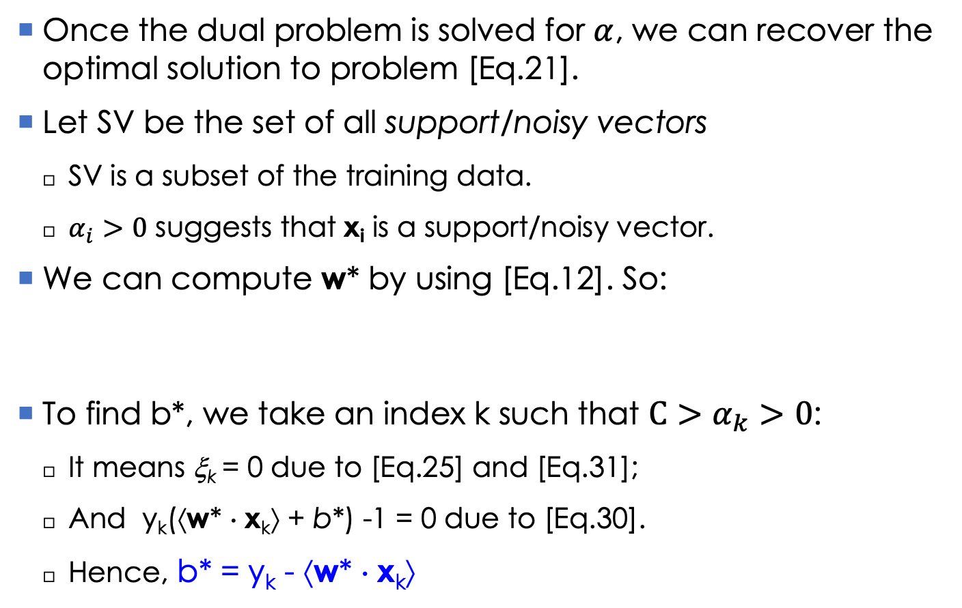
Soft-margin SVM: the optimal classifier
Once the dual problem is solved for $α$, we can recover the optimal solution to problem [Eq.21].
Let SV be the set of all support/noisy vectors
SV is a subset of the training data.
$α_{i}>0$ suggests that x_{i} is a support/noisy vector.
We can compute w* by using [Eq.12]. So:
To find b*, we take an index k such that $C>α_{k}>0$:
It means ξ_{k} = 0 due to [Eq.25] and [Eq.31];
And y_{k}(⟨w* ⋅ x_{k}⟩ + b*) -1 = 0 due to [Eq.30].
Hence, b* = y_{k} - ⟨w* ⋅ x_{k}⟩
(due to $α_{j}=0$ for any x_{j} not in SV)

Slide 34
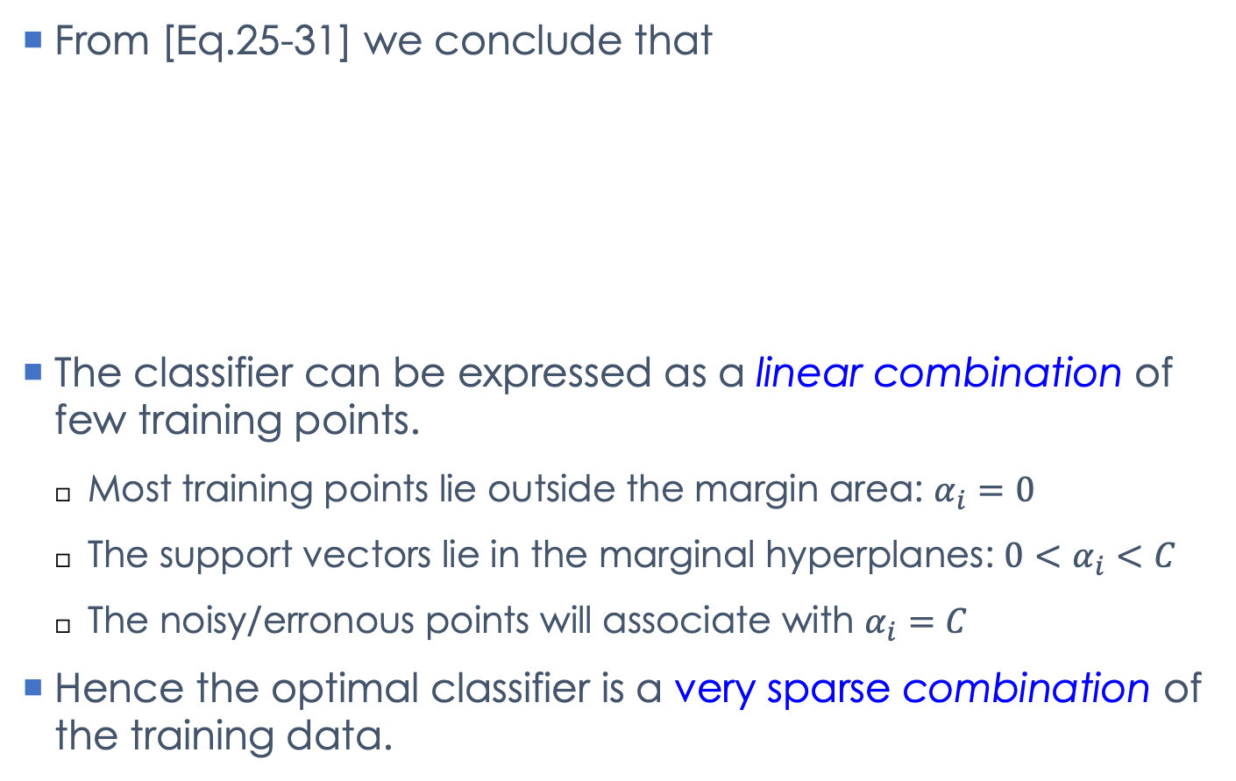
Some notes
From [Eq.25-31] we conclude that
The classifier can be expressed as a linear combination of few training points.
Most training points lie outside the margin area: $α_{i}=0$
The support vectors lie in the marginal hyperplanes: ${0<α}_{i}<C$
The noisy/erronous points will associate with $α_{i}=C$
Hence the optimal classifier is a very sparse combination of the training data.

Slide 35
Soft-margin SVM: classifying new instances
The decision boundary is
For a new instance z, we compute:
If the result is 1, z will be assigned to the possitive class; otherwise z will be assigned to the negative class.
Note: it is important to choose a good value of C, since it significantly affects performance of SVM.
We often use a validation set to choose a value for C.
[Eq.19]
[Eq.20]

Slide 36
Linear SVM: summary
Classification is based on a separating hyperplane.
Such a hyperplane is represented as a combination of some support vectors.
The determination of support vectors reduces to solve a quadratic programming problem.
In the dual problem and the separating hyperplane, dot products can be used in place of the original training data.
This is the door for us to learn a nonlinear classifier.

Slide 37
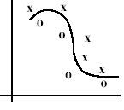
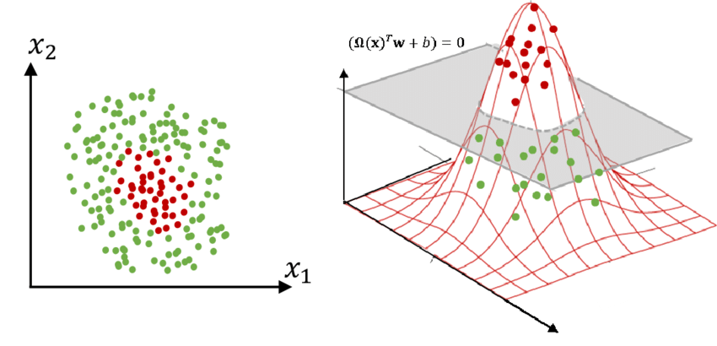
3. Non-linear SVM
Consider the case in which our data are not linearly separable
This may often happen in practice
How about using a non-linear function?
Idea of Non-linear SVM:
Step 1: transform the input into another space, which often has higher dimensions, so that the projection of data is linearly separable
Step 2: use linear SVM in the new space

Slide 38
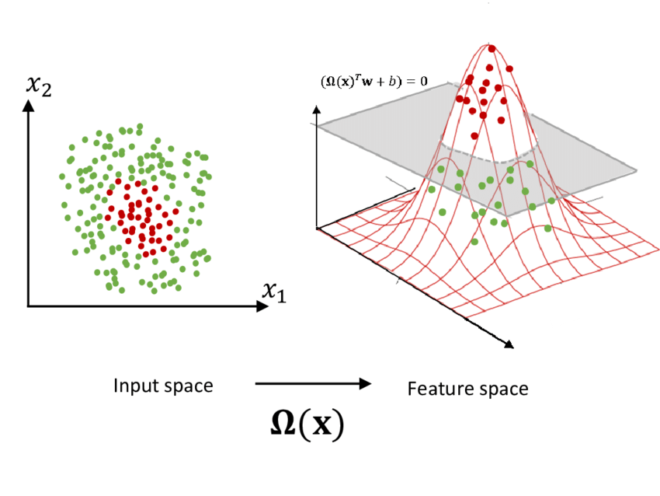

Non-linear SVM
Input space: initial representation of data
Feature space: the new space after the transformation
$$φ(x)$$

Slide 39
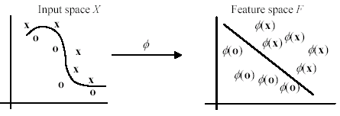
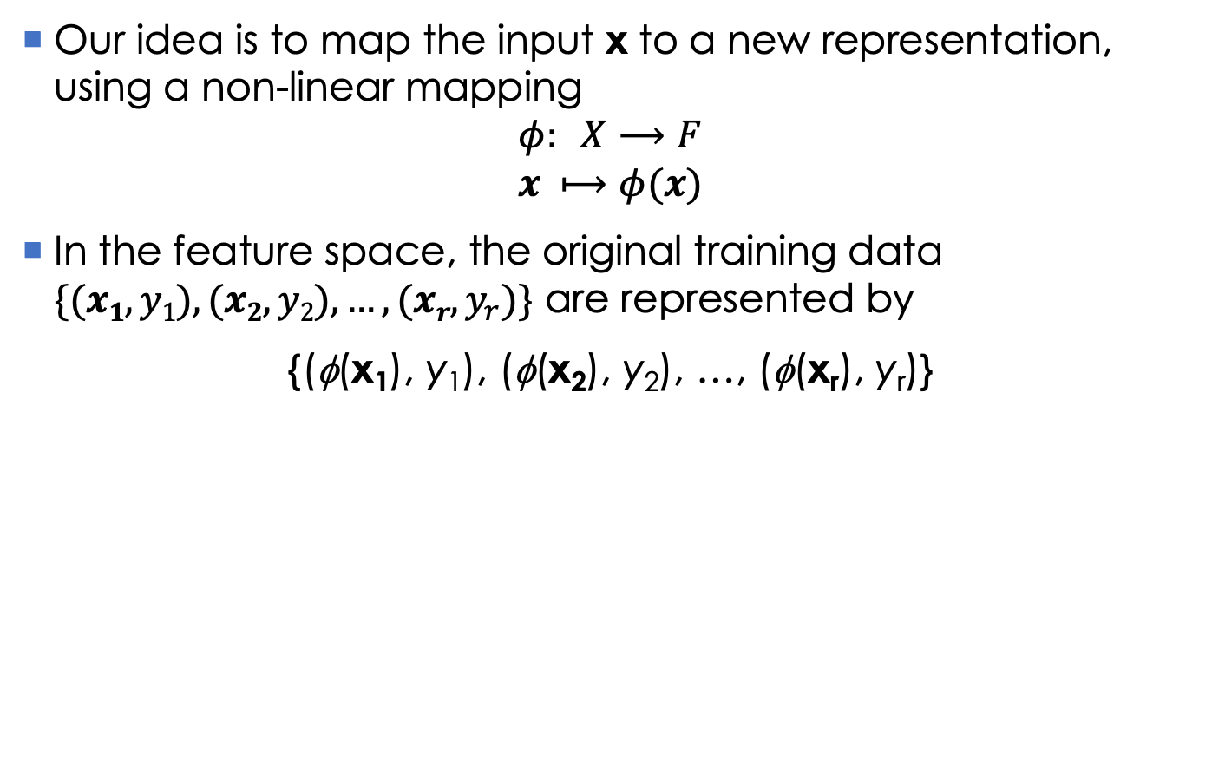
Non-linear SVM: transformation
Our idea is to map the input x to a new representation, using a non-linear mapping
$$φ: X⟶F$$
$$x ⟼φ(x)$$
In the feature space, the original training data $\{(x1, y1), (x2, y2), …, (xr, y_{r})\}$ are represented by
{(φ(x₁), y₁), (φ(x₂), y₂), …, (φ(x_{r}), y_{r})}

Slide 40
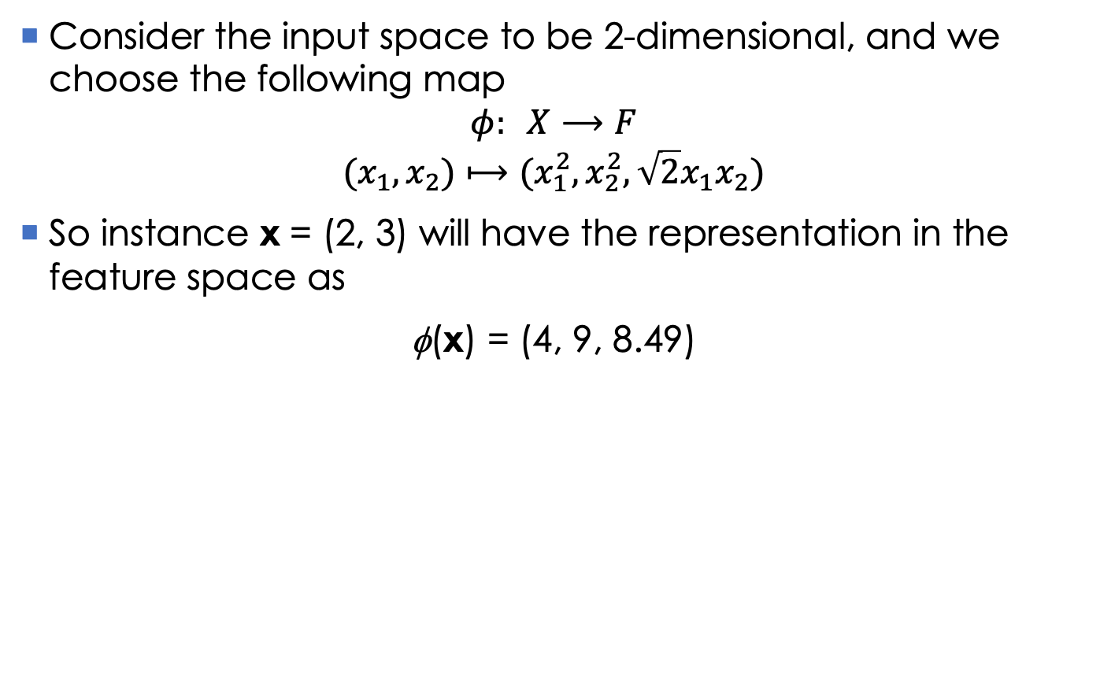
Non-linear SVM: transformation
Consider the input space to be 2-dimensional, and we choose the following map
$$φ: X⟶F$$
$$(x_{1}, x_{2})⟼(x_{1}^{2}, x_{2}^{2}, \sqrt{2}x_{1}x_{2})$$
So instance x = (2, 3) will have the representation in the feature space as
φ(x) = (4, 9, 8.49)

Slide 41
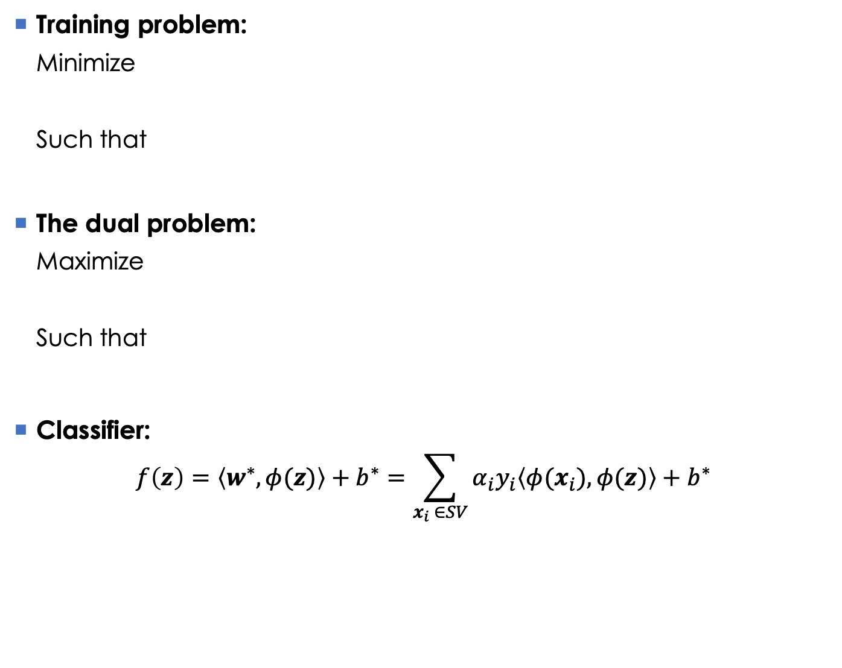
Non-linear SVM: learning & prediction
Training problem:
Minimize
Such that
The dual problem:
Maximize
Such that
Classifier:
$$f\left(z\right)=\left\langle w^{∗},φ(z)\right\rangle +b^{∗}=\sum_{x_{i} ∈SV}{α_{i}y_{i}\left\langle φ(x_{i}),φ(z)\right\rangle }+b^{∗}$$
[Eq.34]
[Eq.35]
[Eq.36]

Slide 42
Non-linear SVM: difficulties
How to find the mapping?
An intractable problem
The curse of dimensionality
As the dimensionality increases, the volume of the space increases so fast that the available data become sparse.
This sparsity is problematic.
Increasing the dimensionality will require significantly more training data.
Dữ liệu dù thu thập được lớn đến đâu thì cũng là quá nhỏ so với không gian của chúng

Slide 43
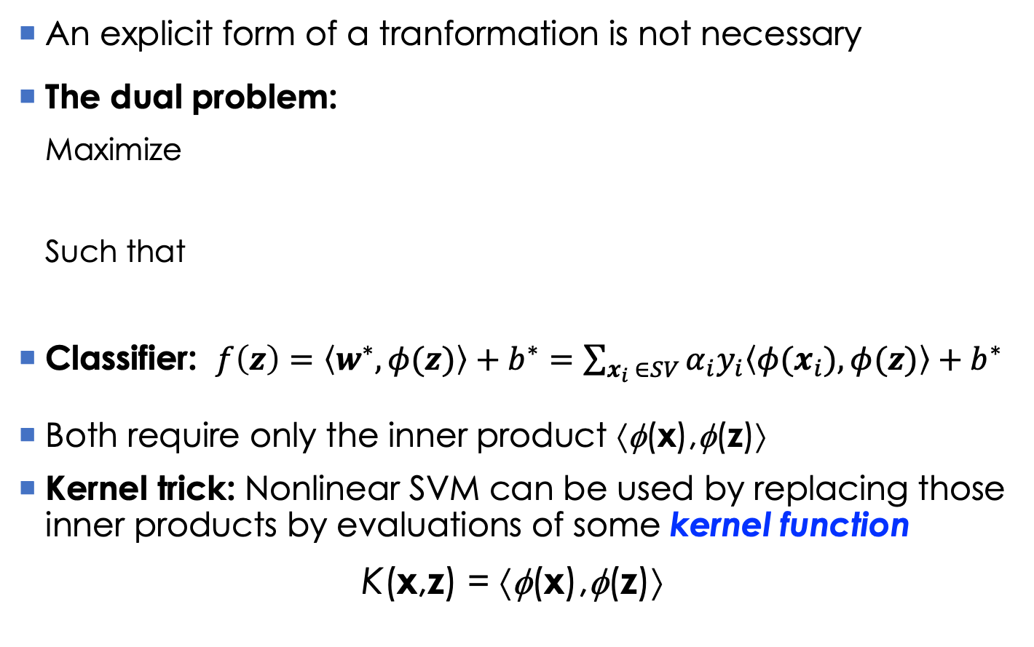
Non-linear SVM: Kernel functions
An explicit form of a tranformation is not necessary
The dual problem:
Maximize
Such that
Classifier: $f\left(z\right)=\left\langle w^{∗},φ(z)\right\rangle +b^{∗}=\sum_{x_{i} ∈SV}{α_{i}y_{i}\left\langle φ(x_{i}),φ(z)\right\rangle }+b^{∗}$
Both require only the inner product ⟨φ(x),φ(z)⟩
Kernel trick: Nonlinear SVM can be used by replacing those inner products by evaluations of some kernel function
K(x,z) = ⟨φ(x),φ(z)⟩
[Eq.37]

Slide 44
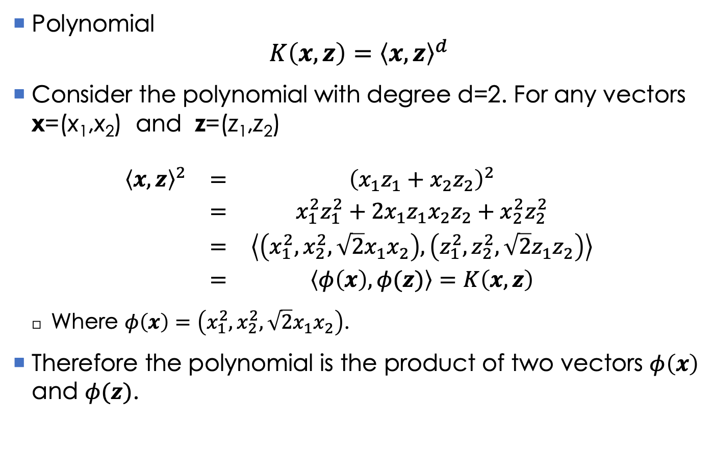
Kernel functions: example
Polynomial
$$K\left(x,z\right)={\left\langle x, z\right\rangle }^{d}$$
Consider the polynomial with degree d=2. For any vectors x=(x₁,x₂) and z=(z₁,z₂)
$$\begin{matrix}{\left\langle x, z\right\rangle }^{2} & = & {\left(x_{1}z_{1}+x_{2}z_{2}\right)}^{2} \\ & = & x_{1}^{2}z_{1}^{2}+2x_{1}z_{1}x_{2}z_{2}+x_{2}^{2}z_{2}^{2} \\ & = & \left\langle \left(x_{1}^{2}, x_{2}^{2}, \sqrt{2}x_{1}x_{2}\right),\left(z_{1}^{2}, z_{2}^{2}, \sqrt{2}z_{1}z_{2}\right)\right\rangle \\ & = & \left\langle φ\left(x\right),φ(z)\right\rangle =K\left(x,z\right)\end{matrix}$$
Where $φ\left(x\right)=\left(x_{1}^{2}, x_{2}^{2}, \sqrt{2}x_{1}x_{2}\right)$.
Therefore the polynomial is the product of two vectors $φ\left(x\right)$ and $φ(z)$.

Slide 45
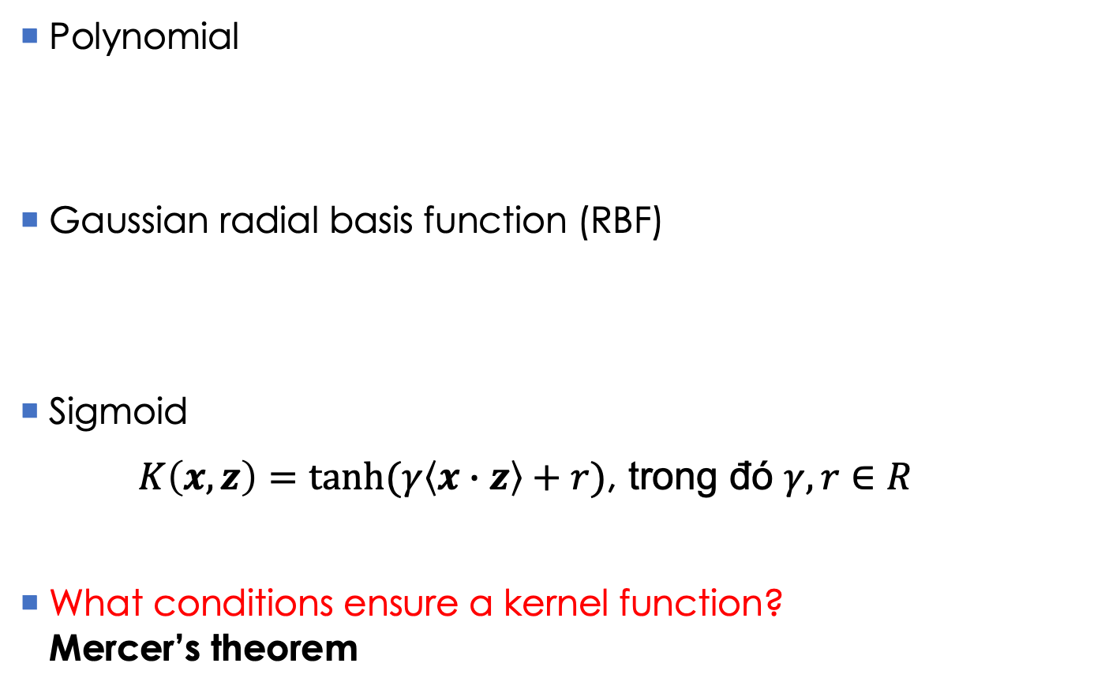
Kernel functions: popular choices
Polynomial
Gaussian radial basis function (RBF)
Sigmoid
$K\left(x,z\right)=tanh⁡(γ\left\langle x∙z\right\rangle +r)$, trong đó $γ,r∈R$
What conditions ensure a kernel function? Mercer’s theorem

Slide 46
SVM: summary
SVM works with real-value attributes
Any nominal attribute need to be transformed into a real one
The learning formulation of SVM focuses on 2 classes
How about a classification problem with > 2 classes?
One-vs-the-rest, one-vs-one: a multiclass problem can be solved by reducing to many different problems with 2 classes
The decision function is simple, but may be hard to interpret
It is more serious if we use some kernel functions

Slide 47
SVM: some packages
LibSVM:
http://www.csie.ntu.edu.tw/~cjlin/libsvm/
Linear SVM for large datasets:
http://www.csie.ntu.edu.tw/~cjlin/liblinear/
http://www.cs.cornell.edu/people/tj/svm_light/svm_perf.html
Scikit-learn in python:
http://scikit-learn.org/stable/modules/svm.html
SVM^{light}:
http://www.cs.cornell.edu/people/tj/svm_light/index.html

Slide 48
References
B. Liu. Web Data Mining: Exploring Hyperlinks, Contents, and Usage Data. Springer, 2006.
C. J. C. Burges. A Tutorial on Support Vector Machines for Pattern Recognition. Data Mining and Knowledge Discovery, 2(2): 121-167, 1998.
Cortes, Corinna, and Vladimir Vapnik. "Support-vector networks." Machine learning 20.3 (1995): 273-297.

Slide 49
Exercises
What is the main difference between SVM and KNN?
How many support vectors are there in the worst case? Why?
The meaning of the constant C in SVM? Compare the role of C in SVM with that of λ in Ridge regression.

